Slide 1
REVIEW
Guoxingli
2009-11-14

Slide 2
Big Blocks
Algorithms & design
  Sorting
  Divide and Conquer
  Merge sort, Quick sort
  Dynamic programming
  Assembly-line scheduling
  Matrix Chain Multiplication, LCS, Max-Sum
  Greedy
  Activity Selection Problem, Huffman coding
  Graph algorithms
  Bellman-Ford, Dijkstra,
  D^{k}(i,j), Floy-Washall algorithm, Johnson’s algorithm
  Backtracking
  N-queen
Theory of Algorithm
  NP
Algorithms & Analysis

Slide 3
Insertion Sort
Insert Sort algorithm
How to calculate the running time of algorithm
RAM model
count fundamental operations
best case / / average case / / worst case
How to analysis
Correctness---loop invariant
Order of growth

Slide 4
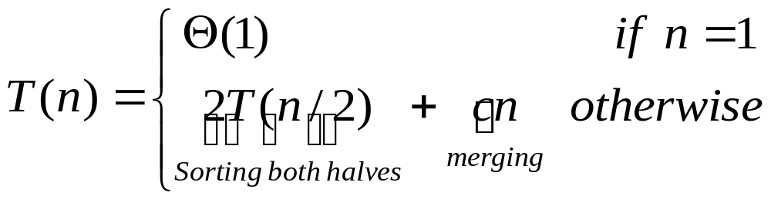
Merge sort
Divide and Conquer
Divide---Conquer---Combine
Merge sort
algorithm
analysis---recurrence
Solution to recurrence
Θ(nlgn)
How to argue the solution
(recursion tree, telescoping,mathematical introduction)

Slide 5
Analysis of algorithm
Worst case
Best case
Average case
Machine model
Lower bound
Upper bound
Optimal algorithm

Slide 6
Growth of Functions
Asymptotic Growth
O-notation
Ω-notation
Θ-notation

Slide 7
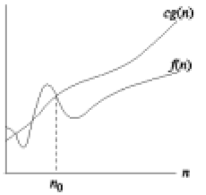
O-notation
O(g(n)) = {f(n): There exist positive constants c and n₀ such that 0≤f(n) ≤cg(n) for all n≥n₀}
--O(.) is used to asymptotically upper bound a function.
--O(.) is used to bound worst-case running time.

Slide 8
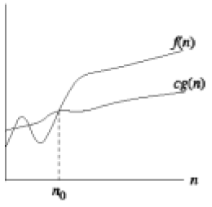
Ω-notation
Ω(g(n)) = {f(n): There exist positive constants c and n₀ such that 0 ≤ cg(n) ≤f(n) for all n≥n₀}
--We use Ω-notation to give a lower bound on a function.

Slide 9
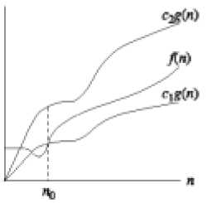
Θ-notation
Θ(g(n)) = {f(n): There exist positive constants c₁, c₂ and n₀ such that 0 ≤ c₁g(n) ≤f(n) ≤c₂g(n) for all n≥n₀}
--We use Θ-notation to give a tight bound on a function.
-- f(n) =Θ(g(n)) if and only if f(n) = O(g(n)) and f(n) = Ω(g(n))

Slide 10
Asymptotic Growth
How to use?
How to analysis?
How to comprehensive understand?
How to avoid abuse?
Mathematic Backgrouds

Slide 11
Recurrences
Substitution method
Recursion-tree method
Master method

Slide 12
Substitution method
The most general method:
-- Guess the form of the solution
-- Verify by induction
-- Solve for constants
Ex. T(n) = 4T(n/2) + 100n
-- Assume that T(1) = Θ(1)
-- Guess O(n³). (Prove O and Ω separately.)
-- Assume that T(k) ≤ck³ for k < n
-- Prove T(n) ≤cn³ by induction
Pay attention to constants in the equation!

Slide 13

Avoiding Pitfalls
Be careful not to misuse asymptotic notation. For example:
-- We can falsely prove T(n) = O(n) by guessing T(n) ≤cn for T(n) = 2T( ) + n
T(n) ≤ 2c + n
≤ cn + n
= O(n)
Wrong
-- The error is that we haven’t proved the exact form of the inductive hypothesis T(n) ≤ cn.

Slide 14
Recursion - tree method
A recursion tree models the costs (time) of a recursive execution of an algorithm.
The recursion tree method is good for generating guesses for the substitution method.
the recursion-tree method can be unreliable, just like any method that uses ellipsis (…).
The recursion-tree method promotes intuition, however.

Slide 15
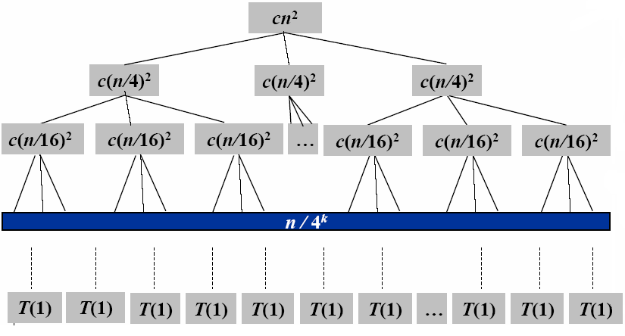
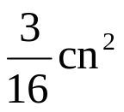
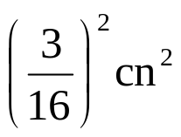


T(n) = 3T(n/4) + Θ(n2)
cn²
log₄n+1
Geometric series
Total: O(n²)
The fully expanded tree has lg₄n+1 levels, i.e., it has height lg₄n

Slide 16
Master Method
It provides a “cookbook” method for solving recurrences of the form:
T(n) = a T(n/b) + f(n)
Where a ≥ 1 and b > 1 are constants and f(n) is an asymptotically positive function.

Slide 17
Three common cases
Compare f(n) with n^{log}bª :
  1. f(n) = O(n^{log}bª ^{–ε}) for some constantε> 0
    f(n) grows polynomially slower than n^{log}bª (by an nε factor),
    Solution: T(n) = Θ(n^{log}bª)
  2. f(n) = Θ(n^{log}bªlg^{k}n) for some constant k≥ 0
    f(n) and n^{log}bª grow at similar rates,
    Solution: T(n) = Θ(n^{log}bªlg^{k+1}n)
  3. f(n) = Ω(n^{log}bª ^{–ε}) for some constantε> 0
    f(n) grows polynomially faster than nlogba (by an nε factor),
    and f(n) satisfies the regularity condition that af(n/b) ≤cf(n) for some constant c < 1
    Solution: T(n) = Θ(f(n))

Slide 18
Heap Sort
HEAP
MAX-HEAPIFY
BUILD-MAX-HEAP
HEAPSORT

Slide 19
Priority queue
--INSERT(S, x)
>>inserts the element x into S
--MAXIMUM(S)
>>returns the element of S with the largest key
--EXTRACT-MAX(S)
>>removes and returns the element of S with the largest key
--INCREASE-KEY(S, x, k)

Slide 20
Quick Sort
Divide and conquer
Partition
Analysis of quick sort
best case
worst case
average case
Randomized quick sort

Slide 21
Comparison of all these sorting algorithms
Insertion sort
Merge sort
Heap sort
Quick sort

Slide 22
Linear sorting
Counting sort
Radix sort
Bucket sort
If **** then

Slide 23
Medians and Order Statistics
Maximum
Minimum
Median
Selection
Randomized Selection
Worst-case linear time selection

Slide 24
Dynamic Programming
Dynamic Programming Paradigm
Four-step method:
1. Characterize the structure of the optimal solution.
2. Recursively define the value of the optimal solution.
3. Compute the value of the solution in a bottom-up fashion.
4. Construct the optimal solution using the computed information.
Bottom-up Optimization Problem

Slide 25
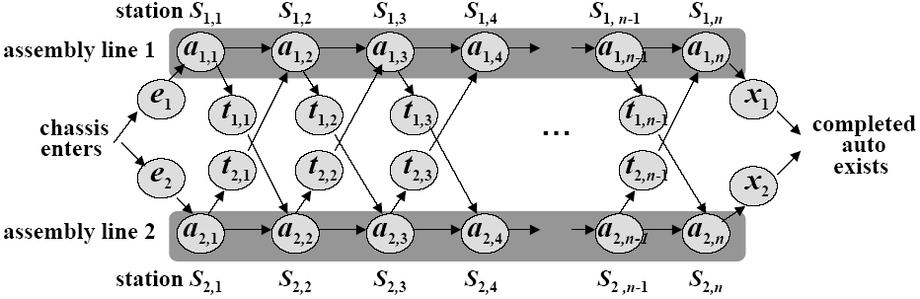
Assembly-line scheduling

Slide 26


Recursive Formula
Let f_{i}[j] denote the fastest possible time (which is the values of optimal solution, optimal substructure) to get the chassis through S_{i,j}
Have the following formulas:
Using symmetric reasoning, we can get the fastest way through station S_{2,j}
Total time:

Slide 27
Matrix-chain multiplication
Goal. Given a sequence of matrices A₁,A₂,…,A_{n}, find an optimal order of multiplication.
Multiplying two matrices of dimension p×q and q×r, takes time which is dominated by the number of scalar multiplication, which is pqr.
Generally. A_{i} has dimension p_{i-1}×p_{i} and we’d like to minimize the total number of scalar multiplications.

Slide 28
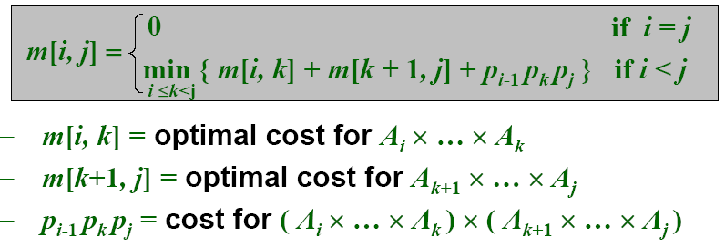
A recursive formulation
We would like to find the split that uses the minimum number of multiplications. Thus,
To obtain the actual parenthesization, keep track of the optimal k for each pair (i,j) as s[i,j].

Slide 29
Elements of DP Algorithms
Optimal substructure (principle of optimality)
  An optimal solution to the problem contains within its optimal solutions to subproblems.
Optimal substructure varies across problem domains in two ways:
  How many subproblems are used in an optimal solution to the original problem
  How many choices we have in determining which subproblem(s) to use in an optimal solution.
  Optimal substructure
  Overlapping Subproblems

Slide 30
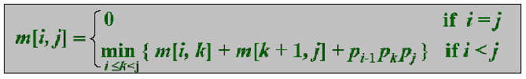
Elements of DP Algorithms
In assembly-line scheduling
We had Θ(n) subproblems overall and only two choices to examine for each, yielding a Θ(n) running time.
  f * = min( f₁[n] + x₁, f₂ [n]+x₂)
For matrix-chain multiplication
There were Θ(n²) subproblems overall, and in each we had at most n –1 choices, giving an O(n³) running time.

Slide 31
Down Recursive VS Bottom Up DP
Bottom-up dynamic programming algorithm
  More efficient
    regular pattern of table access can be exploited to reduce time or space
    take advantage of the overlapping-subproblems property.
Top-down recursive algorithm
    repeatedly resolve each subproblem each time it appears in the recursion tree.
    recursion overhead
    Only work when the total number of subproblems in the recursion is small.

Slide 32
Memoization
A variation of dynamic programming
  offers the efficiency of the usual dynamic programming approach while maintaining a top-down strategy.
Ideas:
  to memoization the natural, but inefficient , recursive algorithm.
  A memoized recursive algorithm maintains an entry in a table for the solution to each subproblem.
  Initially contain a special value to indicate that the entry has yet to be filled in. when the subproblem is first encountered during the execution of the recursive algorithm, its solution is computed and then stored in the table.

Slide 33
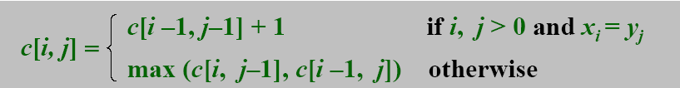
Longest Common Subsequence
There is a third strand S₃ in which the bases in S₃ appear in each of S₁ and S₂; these bases must appear in the same order, but not necessarily consecutively. The longer the strand S₃ we can find, the more similar S₁ and S₂ are. (we focus on this)

Slide 34
Max Sum - DP
Define b[j]=max(sum(i:j)), 1<=i<=j.
  max(b[k]),1<=k<=n is ms(1,n) , what we want.
b[j]=max( b[j-1]+a[j], a[j] ), 1<=j<=n.

Slide 35
Activity-Selection Problem
Problem: Given a set A = {a₁, a₂, …, a_{n}} of n activities with start and finish times (s_{i}, f_{i}), 1 ≤ i ≤ n, select maximal set S of “non-overlapping” activities.

Slide 36
Greedy choice property
Theorem 16.1 Consider any nonempty subproblem S_{ij}, and let a_{m} be the activity in S_{ij} with the earliest finish time: f_{m} = min{ f_{k} : a_{k} ∈ S_{ij} }.
  Then
  1. Activity a_{m} is used in some maximum-size subset of mutually compatible activities of S_{ij}.
  2. The subproblem S_{im} is empty, so that choosing a_{m} leaves the subproblem S_{mj} as the only one that may be nonempty.
The above is a statement claiming that Activity Selection has the greedy choice property.

Slide 37
When Greedy Algorithm Works?
How can one tell if a greedy algorithm will solve a particular optimization problem?
There is no way in general. If we can demonstrate the following properties, then it is probable to use greedy algorithm:
  Greedy-choice property
  Optimal substructure (the same with that of dynamic programming)

Slide 38
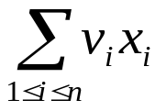
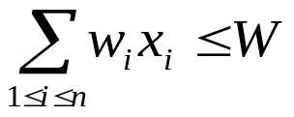
Knapsack Problem
To illustrate the subtleties between the two techniques, let us investigate two variants of a classical optimization problem.
  0-1 knapsack problem
    0-1 knapsack problem: A thief robs a store and finds n items, with item i being worth $v_{i} and having weight w_{i} pounds, The thief can carry at most W ∈ N in his knapsack but he wants to take as valuable a load as possible. Which item should he take?
    i.e., is maximized and s.t.
  Fractional knapsack problem
    The setup is the same, but the thief can take fractions of items.

Slide 39
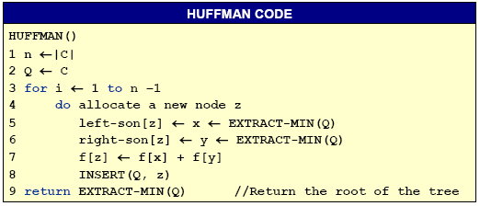
Algorithm of Huffman Coding
The greedy algorithm for computing the optimal Human coding tree T is as follows.
  It starts with a forest of one-node trees representing each c ∈C, and merges them in a greedy style, using a priority queue Q, sorted by the smallest frequency:

Slide 40
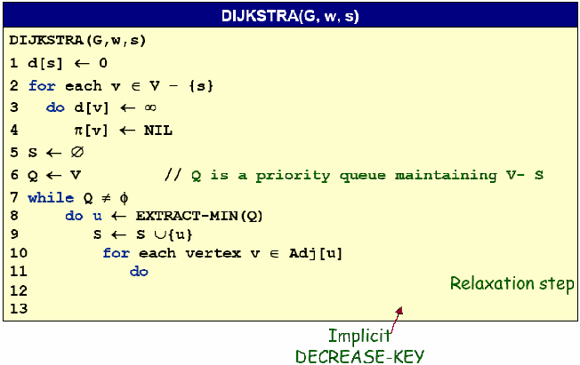

Dijkstra’s algorithm

Slide 41
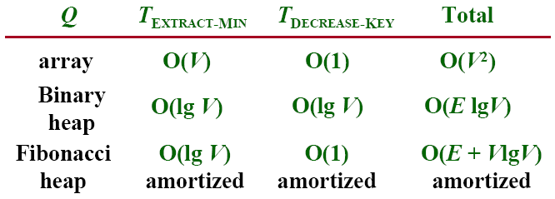
Analysis of Dijkstra’s algorithm
Time=Θ(V.T_{EXTRACT-MIN}+E.T_{DECREASE-KEY})

Slide 42
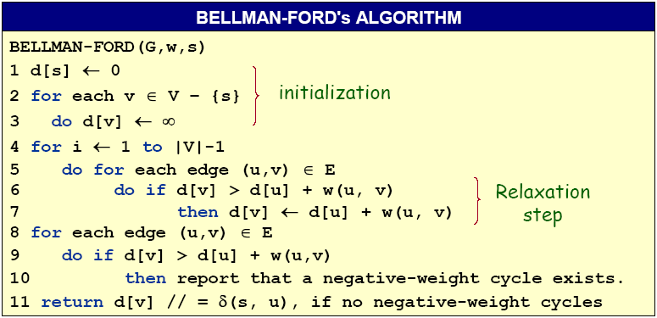
Bellman-Ford algorithm
Time=O(VE)

Slide 43
All-pairs shortest paths
All-pairs shortest paths
  d^{(m)}_{ij} = min_{k}{d^{(m-1)}_{ik}+a_{kj} }
  (min,+) multiplication
  Improved matrix multiplication algorithm.
Floy-Warshall algorithm
  c_{ij}^{(k)}=min_{k}{c_{ij}^{(k-1)},c_{ik}^{(k-1)}+c_{kj}^{(k-1)}}
Johnson’s algorithm
  Graph reweighting
    h: V→R, reweight (u,v) ∈E by w_{h}(u,v)=w(u,v)+h(u)-h(v).
  Algorithm:
    Find a function h: V→R, such that w_{h} (u,v) ≥0 for all (u,v) ∈E by using Bellman-Ford
    using w_{h} from Run Dijkstra’s algorithms each vertex u∈V
    For each (u,v)∈V*V, computeδ(u,v)=δ_{h}(u,v)-h(u)+h(v)

Slide 44
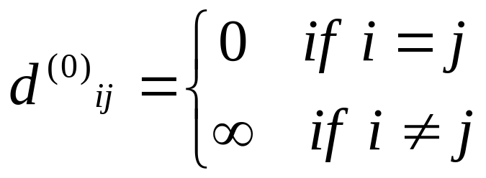
Dynamic programming
Consider the n*n adjacency matrix A=(a_{ij}) of the graph, and define
d^{(m)}_{ij} =weight of a shortest path from i to j that uses at most m edges.
Claim: We have
And for m=1,2,…,n-1: d^{(m)}_{ij}=min_{k}{d^{(m-1)}_{ik}+a_{kj}}
Analysis: O(n⁴)

Slide 45

Floyd-Warshall algorithm
Also dynamic programming, but faster!
Define c_{ij}^{(k)} weight of a shortest path from i to j with intermediate vertices belonging to the set {1,2,…,k}
Thus, δ(i,j)=c_{ij} ^{(n)}. Also, c_{ij} ⁽⁰⁾=a_{ij} .

Slide 46
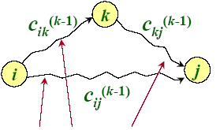
Floyd-Warshall recurrence
c_{ij}^{(k)}=min_{k}{c_{ij}^{(k-1)},c_{ik}^{(k-1)}+c_{kj}^{(k-1)}}
Intermediate vertices in {1,2,…,k}
Analysis : O(n³)

Slide 47
Johnson’ algorithm
1. Find a function h: V→R, such that w_{h} (u,v) ≥0 for all (u,v) ∈E by using Bellman-Ford to solve the different constraints h(v)-h(u) ≤w(u,v), or determine that a negative-weight cycle exists.
--Time=O(VE).
2. Run Dijkstra’s algorithms using w_{h} from each vertex u∈V to compute δh(u,v) for all v ∈V
--Time=O(VE+V²lgV)
3. For each (u,v)∈V*V, compute
δ(u,v)=δ_{h}(u,v)-h(u)+h(v)
--Time=O(V²)
Time=O(VE+V²lgv)

Slide 48
Back-Tracking Paradigm
A design technique, like divide-and-conquer.
Useful for optimization problems and finding feasible solutions.
  Solution to a problem is defined as an n-tuple: (x₁, x₂, …, x_{n}), where x_{i} is taken from a finite set S_{i} . Generally, we need to:
    finding a vector which maximize (or minimize) a specific objective function P(x₁, x₂, …, x_{n}).
    finding a (or all) vector(s) that satisfy a specific criterion function P(x₁, x₂, …, x_{n}).

Slide 49
State Space Tree
state space tree
problem state
state space
x₁ = 1
x₁ = 4
x₁ = 2
x₁ = 3
solution states
answer states
x₂ = 1
2
3
4
1
2
3
4
1
2
3
4
1
2
3
4
x₃ = 1
4
1
4
x₃ = 1
4
2
3
…
2
3
………………………
2
3
x₄ = 1
4
x₄ = 1
4
2
3
…………………………………………………………
2
3

Slide 50
State Space Tree
how did we solve the queen
problem just now ?
DFS, this is the way how Back
Tracking algorithms solve a problem
Begin
x₁ = 4
x₁ = 1
x₁ = 2
x₁ = 3
Identify state space tree
x₂ = 1
2
3
4
1
Yes
4
1
4
1
4
All states?
2
3
2
3
2
3
No
Generate problem state
x₃ = 1
4
1
4
x₃ = 1
4
2
3
…
2
3
………………………
2
3
Is solution state?
x₄ = 1
4
x₄ = 1
4
2
3
…………………………………………………………
2
3
Is answer state?
End

Slide 51
State Space Tree
Begin
x₁ = 1
x₁ = 4
x₁ = 2
x₁ = 3
Identify state space tree
DFS in back Tracking paradigm
Yes
x₂ = 1
4
1
4
1
4
1
4
2
3
2
3
2
3
All states?
2
3
No
Trying to generate all problem states?
Generate problem state
x₃ = 1
4
1
4
x₃ = 1
4
2
3
…
2
3
………………………
2
3
Is solution state?
x₄ = 1
4
No! using bound functions to kill alive nodes
x₄ = 1
4
Is answer state?
2
3
…………………………………………………………
2
3
End
This is how Back-Tracking varies from Brute-Force

Slide 52
General Method of Back Tracking
BACKTRACKING
BACKTRACKING(n)
k←1;
while k>0 do
if there are unchecked X(k), X(k)∈T(X(1),…,X(k-1)) and B(X(1),…,X(k))=true
then if (X(1),…,X(k) is an answer）
then print (X(1),…,X(k))
if (k < n)
k←k+1
else
k←k-1
Construct solution in X(1:n), an answer is output immediately after it is determined.
T(X(1),...,X(k-1)) : returns all possible X(k) ,given X(1),…,X(k-1).
B(X(1),…,X(k)): returns whether X(1),…,X(k) satisfies the implicit constraints.

Slide 53
Back-Tracking Algorithm for n-Queen problem
NQUEENS
NQUEENS(n)
X(1)←0;k←1
while k>0 do
X(k)←X(k)+1
while X(k) ≤ n and not PLACE(k) do
X(k)←X(k)+1
if X(k) ≤ n
then if k=n
then print (X)
else k←k+1;X(k)←0
else k←k-1;
k : current row;
X(k) : column NO of queen k
Finding next valid column NO using bound function PLACE.
Found or not?
Found! Is it an answer?
Print the answer, or shift to the next row and find a place for next queen.
No! Tracking back.

Slide 54
NP
-- Computability
Undecidable Problem
-- Analysis of Algorithms
Polynomial-time Algorithm
UPPER-BOUND LOWER-BOUND
-- NP-Completeness
P NP NP-complete EXP

